Slide 1
PATo
Particle Analysis and Tomography Interface
20/04/2023

Slide 2
Introduction
PATo = [single] Particle Analysis and Tomography [visualisation tool]
Set of services (backend and frontend) that display tomography/SPA experiment information
Gets information from ISPyB
Integration with other tools (such as message queues)
https://github.com/DiamondLightSource/pato-frontend/
https://github.com/DiamondLightSource/pato-backend/

Slide 3
(Some) Supported Features
Traversing through the Z-Axis on a tomogram
Initiating tomogram reprocessing (currently disabled)
Integration with RabbitMQ
Plots for relative ice thickness, drift, CTF data and more
Motion correction and particle picking information
2D and 3D classification overviews, including 3D renderer for MRC files

Slide 4
(Some) Supported Features
OIDC/OAuth2 authentication integration
Authentication can be expanded through modules or disabled
Data caching for faster pagination
Handling of tokens through cookies for extra security and better usability

Slide 5
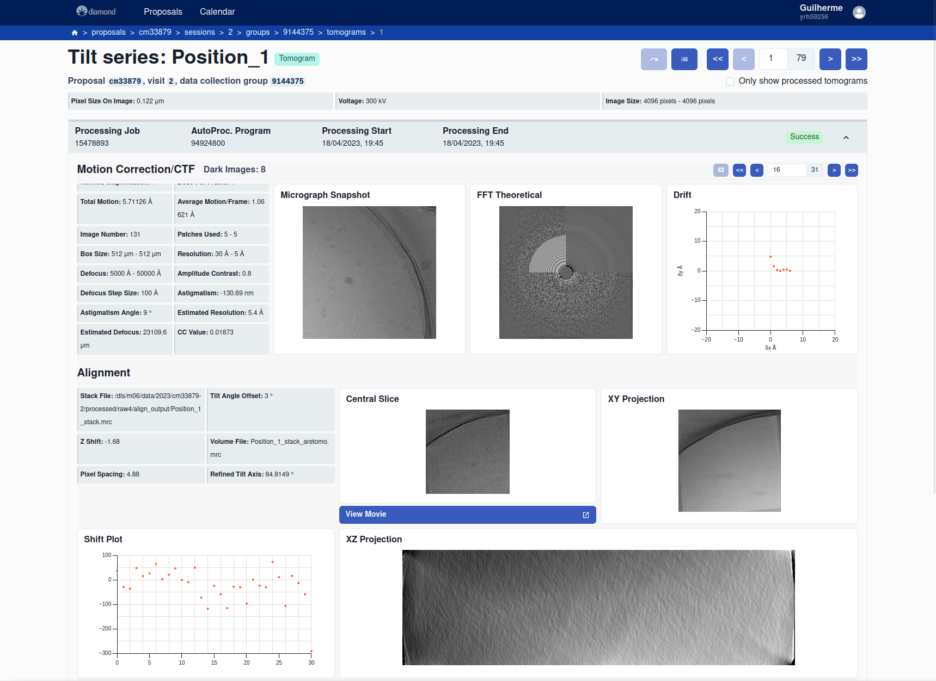
Tomogram data page view

Slide 6
Tomogram movie analysis (traversing through Z axis)

Slide 7
3D visualisation of MRC file in SPA

Slide 8
Planned Features
3D visualisation for subsections of tomograms
On-demand streaming of tomogram data for large files in the future
Integration with Jupyter Notebook
Reprocessing for single particle analysis (already exists in another service inside Diamond)
*Planned features may be altered or outright dropped in the future

Slide 9
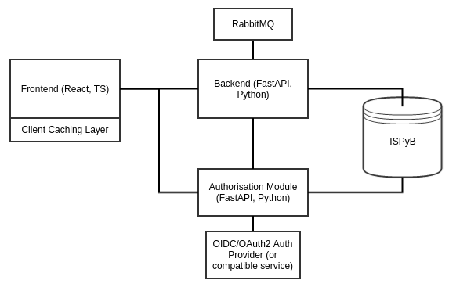
Technology Stack
Frontend
React
Chakra/Personalised component library
Jest for unit testing
Backend/Authorisation Module
Python (FastAPI, SQLAlchemy 2.0)
ISPyB
Pytest for integration testing

Slide 10
Performance
Load all page components on tomogram page (including high-res images)
2.5 seconds (n=10, σ=0.28, no caching)
RAM usage
SPA (2912 motion correction records): 90 MB
With 3D classification renderer: 181 MB
Tomogram (39 motion correction records): 22 MB
With movie viewer: 26 MB

Slide 11
Current Implementation (SPA Pipeline)
Zocalo wrapper running on Hamilton orchestrating workflow
Wrapper sends processing results to ISPyB via Zocalo ISPyB service
Current weaknesses:
Failure of the wrapper leads to failure of the pipeline
Wrapper needs to run for entire data collection (multiple days)
Future developments:
Separate processing steps into services
This has been implemented for the simpler tomography pipeline offered at eBIC

Slide 12
Current Implementation (Tomography Pipeline)
All processing steps separated into Zocalo services running on DLS on-prem Kubernetes cluster
Micrographs collected at various tilt angles
Tilt angles are known approximately
Tilt series, composed of motion corrected micrographs at various angles, are aligned and a tomogram is formed
Services for motion correction, CTF estimation and tomogram reconstruction
Processing triggered on ingress of data to DLS file system from microscope systems

Slide 13
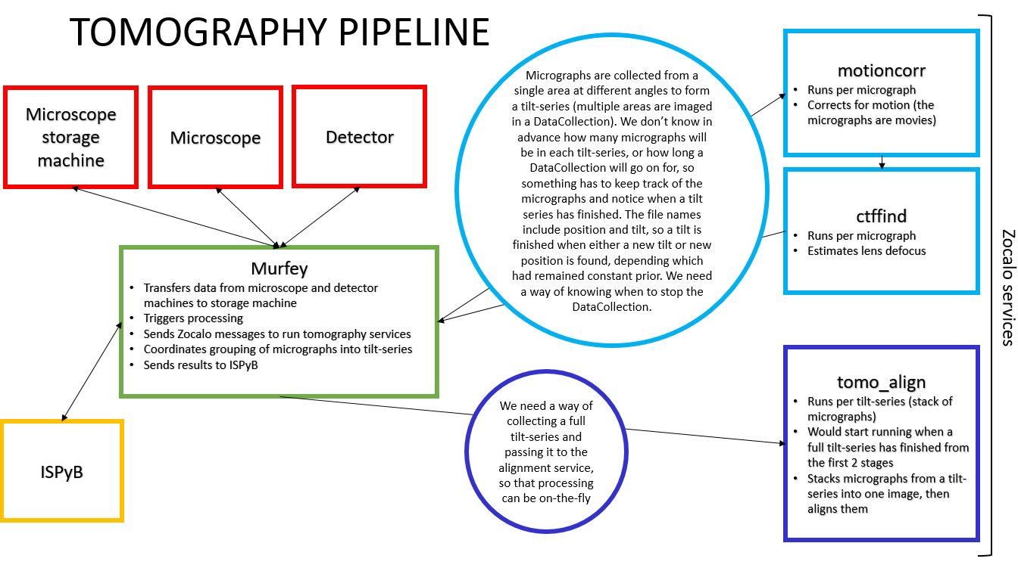

Slide 14
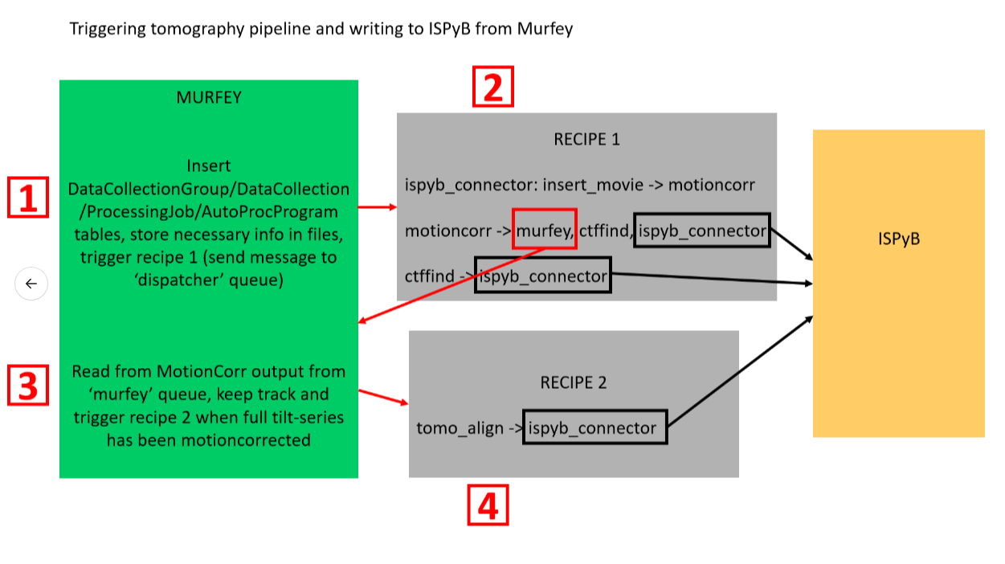

Slide 15
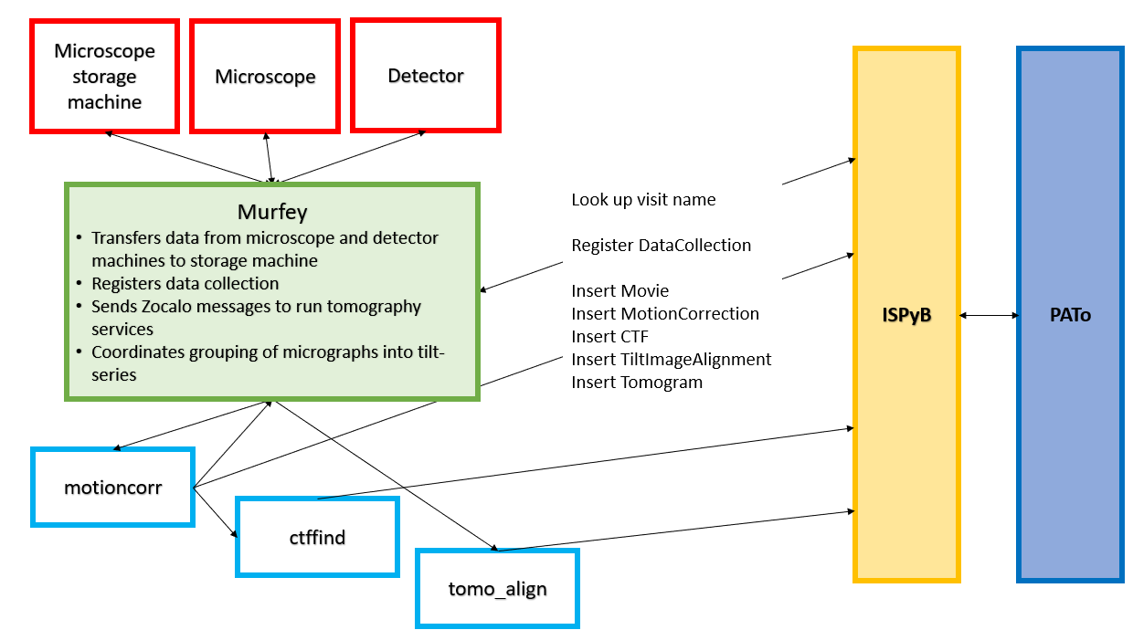
https://github.com/DiamondLightSource/python-murfey

